Slide 1

Tuberculosis in Children
APPROACH TO DIAGNOSIS, & WHEN TO GIVE ISONIAZID PROPHYLAXIS
Dr. Diana Marangu
Consultant Paediatrician and Pulmonologist
27th January 2020

Slide 2
Global TB Report 2018

Slide 3
Global TB Report 2018

Slide 4
Case Presentation
G. S
3 ½ year old female from Malindi
Referral from Nyali Hospital [3/12/2014]
Informant: Grandmother (mother has a 3 month old child at home)

Slide 5
Presenting Complaints
Purulent ear and nose discharge
Nasal lesion with septal destruction
Neck swellings
Cough, fever and weight loss
8/12
What differential diagnoses are you entertaining?
What would you ask next?

Slide 6
Risk factors for tuberculosis (TB)?
Transmission or infection
Contact with TB | Closeness* Duration Smear positivity /cavities on CXR
Who is a close contact?
Adult or adolescent with PTB:-
living in the same household as, or
in frequent contact with (e.g. child minder, school staff)
Paediatric TB DLTLD 2013

Slide 7
Risk factors for tuberculosis (TB)?
Progression to Active TB Disease
Young age | Highest in children < 5 years
Immunosuppression | HIV, malnutrition, post-measles, malignancies
Increased exposure | High TB endemicity*, families living with HIV
Environmental factors | Overcrowding, poor ventilation, indoor air pollution
Is there a difference between TB infection and Active Disease?
Paediatric TB DLTLD 2013

Slide 8
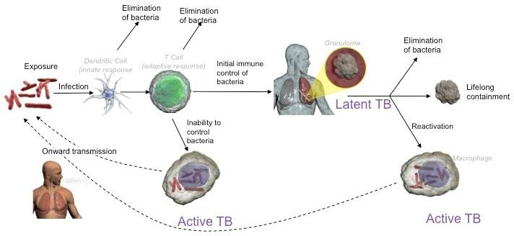
TB Infection versus Active TB Disease
http://www.oxfordimmunotec.com/international/wp-content/uploads/sites/3/natural_history_TB.jpg

Slide 9
Classification of TB
Pulmonary TB (80% of childhood TB) | Extra-pulmonary TB* (TB outside the lung)
Smear positive PTB | Lymph nodes | Kidneys
Smear negative PTB | Pleura | Bladder
 | Pericardium | Skin
 | Meninges | Eyes
 | Bones | Gastro-intestinal system
 | Spine
Paediatric TB DLTLD 2013

Slide 10
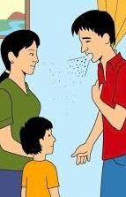
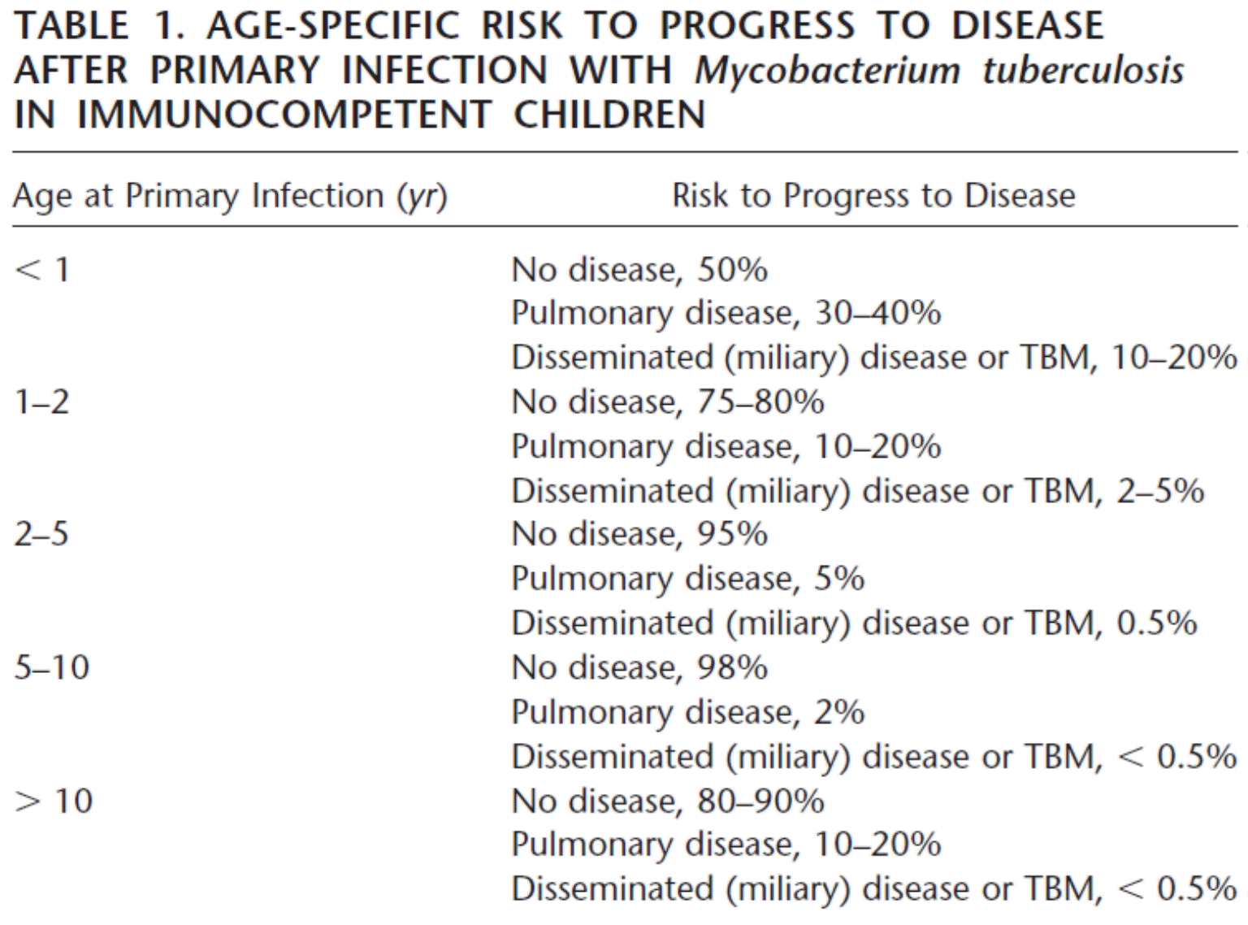
*
http://tbcenfermedadpulmonar.blogspot.com/2013/05/generalidades-de-la-tuberculosis.html
Marais B. Childhood Tuberculosis: Old Wisdom and New Challenges. AJRCCM Vol 173 2006.

Slide 11
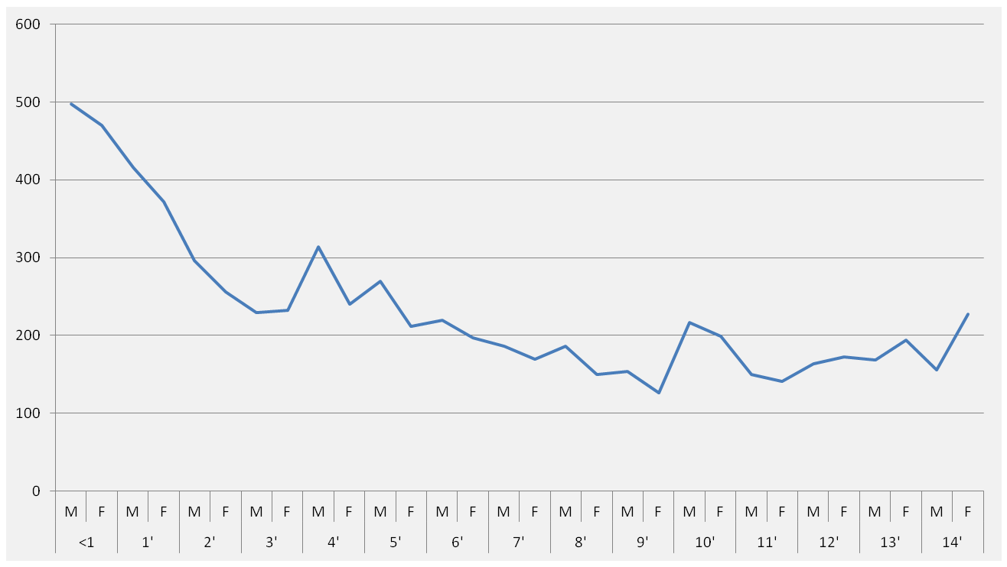
Age distribution of reported TB cases in children, Kenya Data 2011
Number of infants and children
Age of child in years
Paediatric TB DLTLD 2013

Slide 12
History of presenting illness
No known close TB contact
Social history
Five in a 3 bedroomed house, well ventilated, cook using kerosene
No known family member with chronic illness; young sibling is reported to be well

Slide 13
History of presenting illness
Treated twice for pulmonary TB (9/2013; 10/2014)
Symptoms – cough, fever and weight loss
Respiratory signs
Suggestive chest x-rays
Was treatment justified then?

Slide 14
Pulmonary tuberculosis simplified
Presence of 2 or more of the following symptoms
Cough > 2weeks
Weight loss or poor weight gain
Persistent fever and/or night sweats > 2 weeks
Fatigue, reduced playfulness, less active
PLUS
Presence of 2 or more of the following:
Positive contact history
Respiratory signs
CXR suggestive of PTB (where available)
Positive Mantoux test (where available)
Then PTB is likely, and treatment is justified
Paediatric TB DLTLD 2013

Slide 15
Investigations – help support clinical diagnosis
Tuberculin skin test (Mantoux test)
Chest x-ray
Sputum – microscopy, Xpert MTB/Rif, TB culture
If your facility does not have some or all of these tests, rely on the history and physical signs mentioned earlier to make a TB diagnosis.
Absence of tests should not delay diagnosis and treatment of TB.
Paediatric TB DLTLD 2013

Slide 16
Main findings on examination
Severely wasted, generalized lymphadenopathy, finger clubbing
Nasal septum destruction, purulent rhinorrhea and otitis media
Respiratory distress: tachypnea, no central cyanosis
[Right] stony dullness, reduced air entry (lower zone); bronchial breathe sounds (upper zone)
Palpable P2, hepatomegaly 4cm BCM, no splenomegaly/masses
Differentials? What investigations would you like to order now?

Slide 17
Diagnoses entertained
Infectious | Non- Infectious
Mycobacteria tuberculosis Drug resistant? | Primary immunodeficiency – Chronic granulomatous disease?
Other Mycobacterial TB complex | Malignancy
Non-tuberculous Mycobacteria | Wegener’s granulomatosis?
Leprosy | Histiocytosis
Fungal infection | Sarcoidosis?

Slide 18
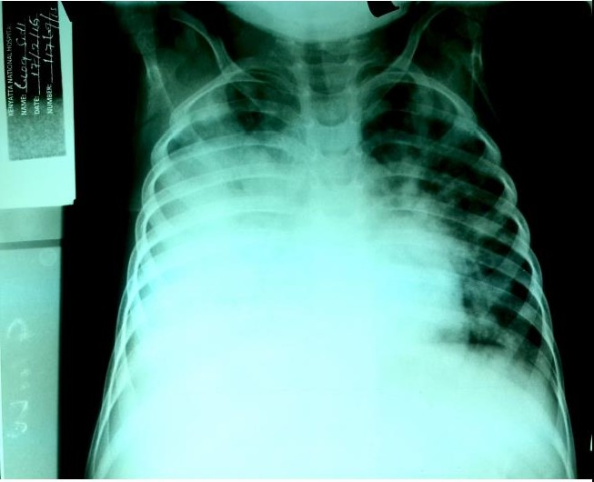
Imaging
Chest radiograph
Chest ultrasound
Echo*
Skull radiograph

Slide 19
Investigations
HIV (PITC) – Negative
Hemogram & BMA– Elevated ESR, features of iron deficiency
Microbiology - Sputum Gene Xpert Negative; TB Cultures pending
FNA: ZN for AFBs negative; reactive lymphadenitis
Histology: Necrotizing chronic granulomatous adenitis suggestive of TB despite negative AFBs, no malignant cells, negative fungal stains
Do we still have TB?

Slide 20
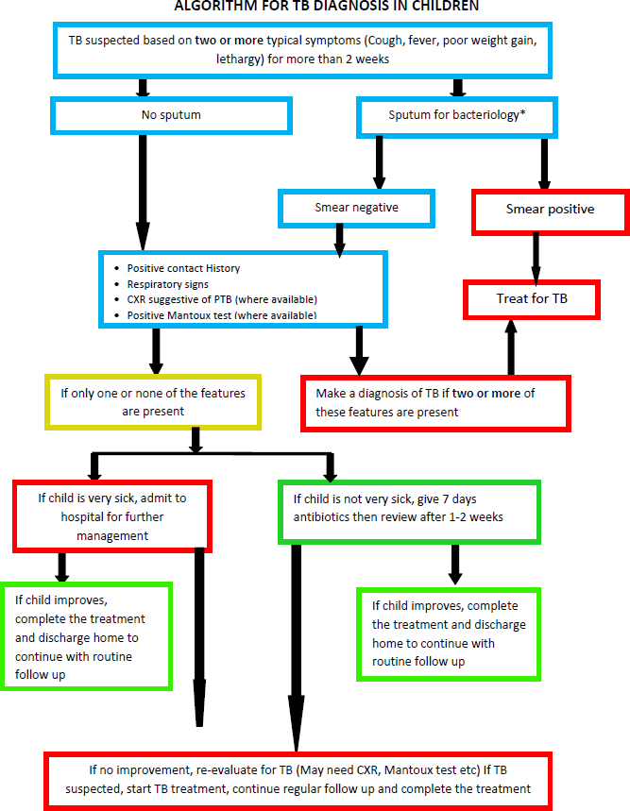
Paediatric TB DLTLD 2013
Paed TB DLTLD 2013

Slide 21
Basic principles of TB treatment
Dosages are calculated according to weight (not age).
Weight is important for monitoring treatment response.
TB drugs are very well tolerated in almost all children.
All children should registered with National TB Program: include age, TB type and outcome
Paediatric TB DLTLD 2013

Slide 22
Treatment regimen
TB Disease Class | Intensive phase | Continuation phase
All forms of TB except TB meningitis /osteoarticular TB | 2 RHZE | 4 RH
TB meningitis Bone and joint TB | 2 RHZE | 10 RH
Drug resistant TB | Refer to a DRTB treatment centre
Paediatric TB DLTLD 2013

Slide 23
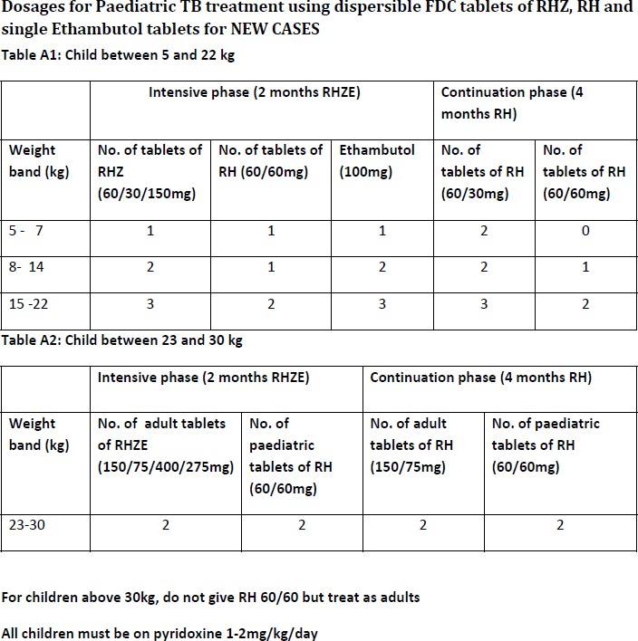
Paediatric TB DLTLD 2013
Paed TB DLTLD 2013

Slide 24
Child Contact Screening
Was this a missed opportunity?

Slide 25
Importance of child contact screening
Identifies asymptomatic child TB contact for isoniazid preventive therapy (IPT)
Identifies children with active TB disease early for treatment

Slide 26
Screening of child contacts for TB
List close contacts
What is the age of the contact?
Is the contact HIV-infected?
Does the contact have any symptoms suggestive of TB?
Checklist of main symptoms
Persistent cough for more than 2 weeks
Weight loss or failure to gain weight
Persistent fever for more than 1 week and/or night sweats
Fatigue, reduced playfulness, less active
Enlarged cervical LN
Paediatric TB DLTLD 2013

Slide 27
Symptom screening
At the end of the screening exercise you should note the following:
Age
HIV status
Is the child symptomatic or not?
If symptom free – give INH preventive therapy if under 5 yrs, and to all HIV+ children
If symptomatic – evaluate for TB
Paediatric TB DLTLD 2013

Slide 28
IPT dose (10mg/kg for 6 months)
Weight | Dose in mg/day | Number of 100 mg, INH tablets
<5 | 50 | ½
5.1 – 9.9 | 100 | 1
10-13.9 | 150 | 1½
14-19.9 | 200 | 2
20-24.9 | 250 | 2½
>25 and adults | 300 | 3
Dose and duration of INH for IPT in children. INH 10 mg/kg/day for 6
months (Maximum 300mg/day) plus Pyridoxine 25 mg/day
Paediatric TB DLTLD 2013

Slide 29
Management of a Child who has been exposed to an adolescent or adult with Pulmonary TB
Paediatric TB DLTLD 2013

Slide 30
5 I’s of TB Control
Intensified Case Finding (ICF)
Isoniazid Preventive Therapy (IPT)
Infection Prevention and Control (IPC)
Integrated Management
Immediate ART for those with TB/HIV co infection.
Paediatric TB DLTLD 2013

Slide 31
Approach to newborn of mother with TB
Examine the placenta immediately upon delivery for tubercles
Evaluate newborn baby for TB disease (signs and symptoms non-specific)
Low birth weight | Poor weight gain
Fever, Irritability | Feed intolerance
Sepsis with poor response to treatment | Hepatosplenomegaly
If no TB, provide IPT for 6 months and follow-up
Paediatric TB DLTLD 2013

Slide 32
Approach to newborn of mother with TB
Continue breast feeding
Delay BCG until 2/52 after IPT is completed
Infection control measures to prevent transmission from mother in newborn care facility
Continue with other routine vaccinations
Paediatric TB DLTLD 2013

Slide 33
Summary
Simplified approach to TB in Children
Know when to give IPT
Patient, health worker and health system factors in TB treatment & prevention
Team work!

Slide 34
Resources
National Guidelines on Management of Tuberculosis in Children, Ministry of Health, Division of Leprosy, Tuberculosis and Lung Disease, Third Edition, August, 2017.
https://www.chskenya.org/wp-content/uploads/2018/03/National-Guidelines-on-Management-of-Tuberculosis-in-Children.pdf
National Leprosy, Tuberculosis and Lung Diseases Unit – Paediatric TB Curriculum Training Slide Set [Paediatric TB DLTLD 2013]
Marais B. Childhood Tuberculosis: Old Wisdom and New Challenges. AJRCCM Vol 173 2006.

